Slide 1
G1 T3
brought to you by Blab-bers
Bid Like A Boss..

Slide 2
Agenda
Follow-ups
Planned Vs Actual
Task Allocation
Metrics
The Way Ahead

Slide 3
Follow-ups (Supervisor Meeting II)
Advices from Supervisor | Follow-up Actions Taken
Assign each programming task to a certain pair. | Done as requested

Slide 4
Schedule Progress (Iter #4 - 20days)
Planned Timeline
Iter #4 Start!
UI (Pre-Heuristic)
Admin Functions & JSON
Round 1 Clearing Logic
UI Improvement
Round 2
Clearing Logic
Iteration Ends
Heuristic
Evaluation
11/10
15/10
17/10
19/10
22/10
27/10
29/10
Iter #4 Start!
UI (Pre-Heuristic)
Admin Functions & JSON
Round 1 Clearing Logic
Round-2
Clearing Logic
UI Improvements
Iteration Ends
12/10
15/10
18/10
19/10
22/10
30/10
31/10
Heuristic
Evaluation
Actual Timeline

Slide 5
Task Allocation #4
Task | Pang Zi Qi | Kong Yu Ning | Kevin Onggo | Nicholas | Nyein Su Aye
Round -1 Clearing Logic | ü |  | ü | ü
UI Improvements |  | ü |  |  | ü
Admin Functions & JSON Responses (Iter #3) | ü |  | ü | ü
Round – 2 Clearing Logic | ü |  | ü | ü
Deployment & Testing | ü |  | ü
Debugging | ü | ü | ü | ü | ü
Quality Assurance | ü | ü | ü | ü | ü

Slide 6
Programming Hours

Slide 7
Current Metrics #4
 | Schedule | Bug | Pair Programming
Score | 0.95 | 3 | 1.14
Action | - | Fixed during the debugging session. | -

Slide 8
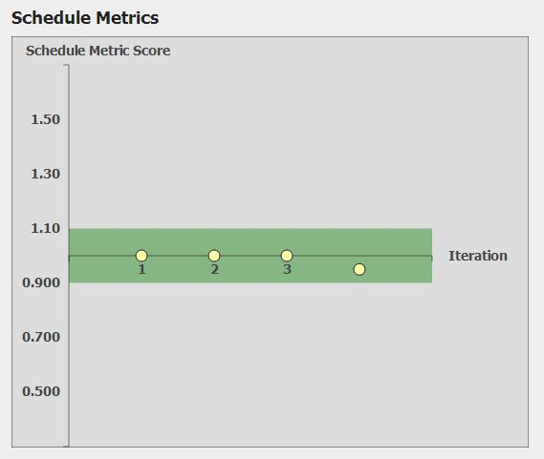

Slide 9
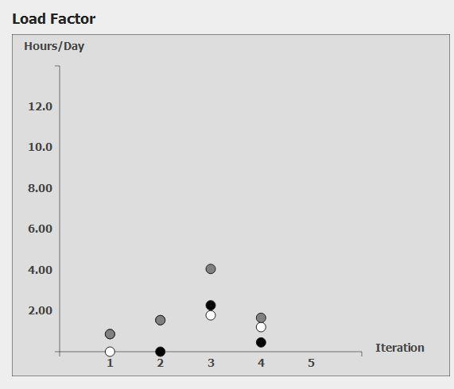
expected

Slide 10
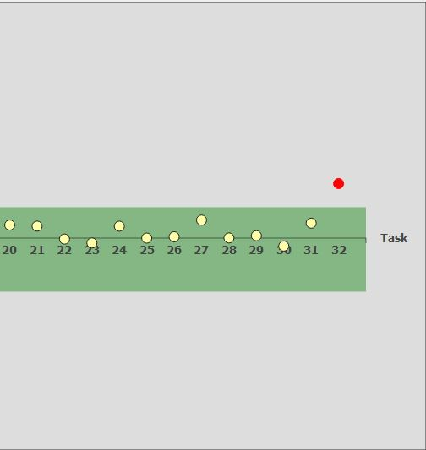
Pair Programming Metric
PPM Score
Debugging
Planned Hours : 6.0
Actual Hours : 2.93
1.5
0.0
0.5

Slide 11
Goals for Next 2 Weeks
Supervisor Meeting
Post UAT Changes
Iteration Ends!!!
Internal UAT
UAT
31/10
1/11
05/11
09/11
10/11
Iteration #4
Preparation for
Final Presentation
(31 Oct – 14 Nov)

Slide 12
Thank You!
brought to you by Blab-bers
Bid Like A Boss..

